Slide 1

Google App Store Data Analysis
- By Swapnil Mane

Slide 2
Introduction
Technology is an increasing need nowadays and used everywhere. One of the features of Technology is android. Which we all use in our daily life. Android is a mobile operating system based on a modified version of the Linux kernel and other open-source software, designed primarily for touchscreen mobile devices such as smartphones and tablets.

Slide 3
Details of Data
Dataset contains-
1.App names, Categories, Ratings, Reviews, Total Installs, Types, Prices, etc.
2.Total 8276 Apps data

Slide 4
Key Insights
Factors Influencing Android Usage
User Engagement and Retention
Device Performance
App Usage Patterns
Market Trends and Competitive Analysis

Slide 5
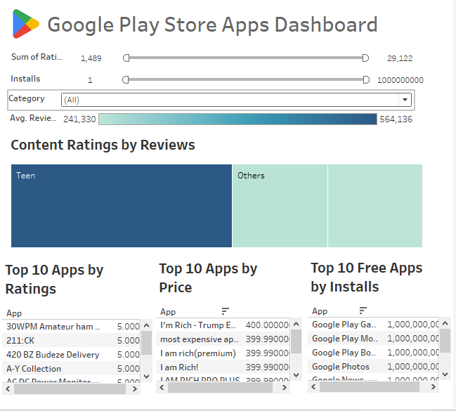
Dashboard

Slide 6
THANK YOU !

